Slide 1

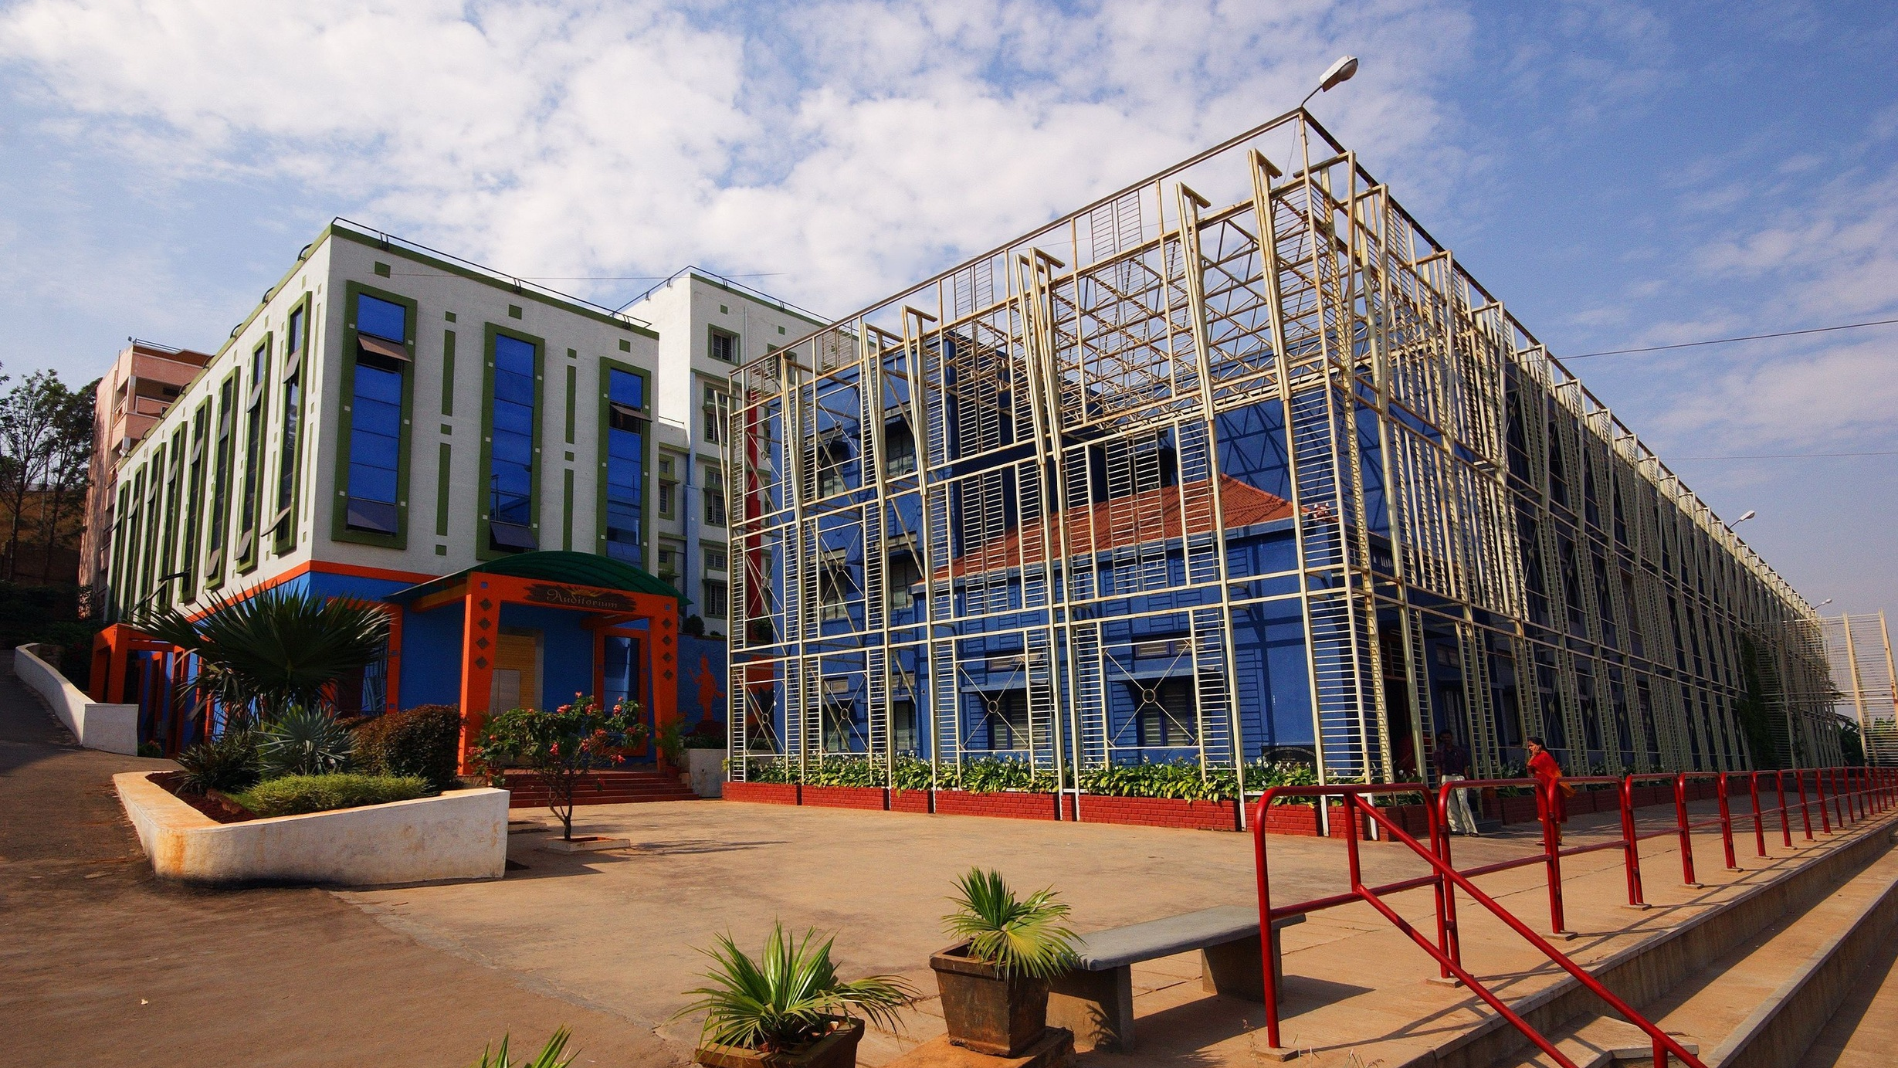



Sri Raghavendra Educational Institutions Society (R)
Sri Krishna Institute of Technology
(Approved by AICTE, Accredited by NAAC, Affiliated to VTU, Karnataka)
Subject: Principles of programming
Code: BPOPS103
Title: Functions-Storage Classes/Recursion
Department: Computer Science and Engg Department
www.skit.org.in

Slide 2
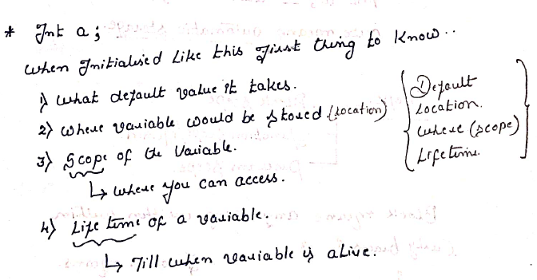
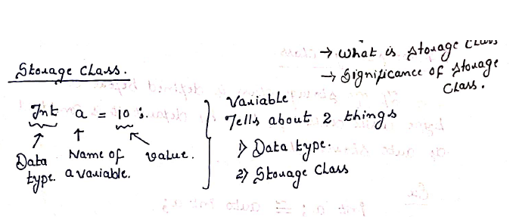
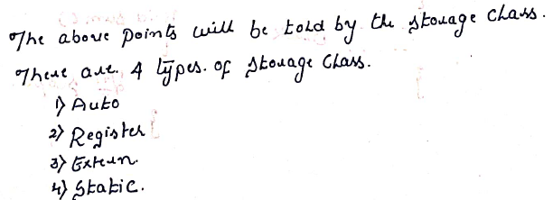




Sri Krishna Institute of Technology
(Approved by AICTE, Accredited by NAAC, Affiliated to VTU, Karnataka)
Auto Storage Class:
Default Value ---- Garbage Value
Scope -------------- Function/block/
Location ----------- Local variables will be
stored in RAM/Stack.
/skit.org.in

Slide 3
Sri Krishna Institute of Technology
(Approved by AICTE, Accredited by NAAC, Affiliated to VTU, Karnataka)
Examples:
//Auto Storage Class
#include<stdio.h>
//auto int x=30;
void main()
{
auto int x=10;
printf("\n Value of x within the function scope is %d", x);
Function {
Scope auto int x=20;
printf("\n Value of x within the block scope is %d", x);
}
printf("\n Value of x within the function scope is %d",++x);
}
Output:
The value of x within the function scope is 10
The value of x within the block scope is 20
The value of x within the function scope is 11
Block Scope
/skit.org.in

Slide 4
Sri Krishna Institute of Technology
(Approved by AICTE, Accredited by NAAC, Affiliated to VTU, Karnataka)
Examples:
//Auto Storage Class
#include<stdio.h>
//auto int x=30;
void main()
{
//If no storage class is specified by default, it is considered auto. Int x=10 is same as auto int x=10;
int x=10;
printf("\n Value of x within the function scope is %d", x);
Function {
Scope auto int x=20;
printf("\n Value of x within the block scope is %d", x);
}
printf("\n Value of x within the function scope is %d",++x);
}
Output:
The value of x within the function scope is 10
The value of x within the block scope is 20
The value of x within the function scope is 11
Block Scope
/skit.org.in

Slide 5
Sri Krishna Institute of Technology
(Approved by AICTE, Accredited by NAAC, Affiliated to VTU, Karnataka)
Examples:
#include<stdio.h>
//auto int x=30;
void main()
{
int x;
printf("\n The value of x with in the function scope is %d", x);
{
auto int x=20;
printf("\n The value of x within the block scope is %d", x);
}
{ int x=10;
printf("\n The value of x with in the function scope is %d", ++x);
}
}
The value of x within the function scope is 31232 //GARBAGE VALUE
The value of x within the block scope is 20
The value of x within the function scope is 11
/skit.org.in

Slide 6
Sri Krishna Institute of Technology
(Approved by AICTE, Accredited by NAAC, Affiliated to VTU, Karnataka)
C doesn’t support the global declaration of the auto-storage class.
//Remove the comment for auto int x=30 declared globally.
#include<stdio.h>
auto int x=30;
void main()
{
int x=10;
printf("\n Value of x with in the function scope is %d", x);
{
auto int x=20;
printf("\n Value of x within the block scope is %d", x);
}
printf("\n Value of x with in the function scope is %d", ++x);
}
Output:
/tmp/uUtudkOfwU/main.c:3:10: error: file-scope declaration of 'x' specifies 'auto'
/skit.org.in

Slide 7
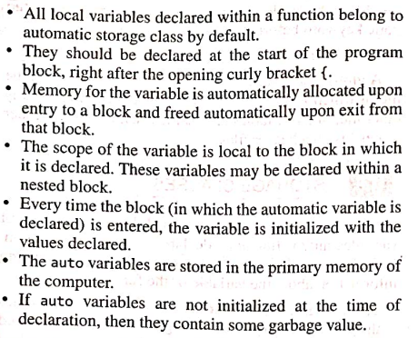
Sri Krishna Institute of Technology
(Approved by AICTE, Accredited by NAAC, Affiliated to VTU, Karnataka)
Auto storage: Points to remember:
/skit.org.in

Slide 8
Sri Krishna Institute of Technology
(Approved by AICTE, Accredited by NAAC, Affiliated to VTU, Karnataka)
Register Storage Class:
Syntax: register int a;
Default Value ---- Garbage Value
Scope -------------- Function/Method
Location ----------- CPU Register
Example:
#include<stdio.h>
Int main()
{
register int i, sum=0;
for(i=0;i<10;i++)
sum= sum + i;
printf("%d\n", sum);
}
OUTPUT: 45
/skit.org.in

Slide 9
Sri Krishna Institute of Technology
(Approved by AICTE, Accredited by NAAC, Affiliated to VTU, Karnataka)
RAM
The program consists of instructions and variables. Processing is done using registers, and values are stored in memory.
Here we switch frequently from CPU to RAM and again from RAM to CPU. i.e. fetching data from RAM, processing done within the CPU and again storing back the updated values in the RAM. (i and sum values)
Disadvantage:
Processing is done at a faster rate but switching takes time thus
Reducing efficiency
Increasing run time
i
sum
CPU
Registers
Switching takes place from RAM To Register
Processing done
/skit.org.in

Slide 10
Sri Krishna Institute of Technology
(Approved by AICTE, Accredited by NAAC, Affiliated to VTU, Karnataka)
To avoid the disadvantage and switching process, the better option is to store the values within the registers.
CPU
Advantages:
Quickly accessing the variables.
Decrease in the run time of the program
Increase in the efficiency.
Switching time is removed when variables are stored in the register.
Registers
i
sum
You may ask, if we can use the register for all variables in the programs we write.
The answer is NO because the storage capacity of the registers is in KB.
Processing done
/skit.org.in

Slide 11
Sri Krishna Institute of Technology
(Approved by AICTE, Accredited by NAAC, Affiliated to VTU, Karnataka)
Now the question is:
Which variables do we need to store in the register?
Answer is:
Variables that we frequently use can be stored in registers.
Example:
Counter variable
Loop variables.
Sum variable in our example
Note: it’s not guaranteed that register variables are stored in the register. Rather, it depends on hardware and implementation restrictions. i.e., to store the variable in the register, the compiler checks whether memory in the data register is available.
If no space in the data registers to store the variable, then by default it is considered as auto.
/skit.org.in

Slide 12
Sri Krishna Institute of Technology
(Approved by AICTE, Accredited by NAAC, Affiliated to VTU, Karnataka)
Example:
//REGISTER STORAGE CLASS
#include<stdio.h>
//register int x=30;
void main()
{
register int x;
printf("\n Value of x with in the function scope is %d", x);
{
auto int x=20;
printf("\n Value of x within the block scope is %d", x);
}
{ int x=10;
printf("\n Value of x within the function scope is %d", ++x);
}
}
OUTPUT:
The value of x within the function scope is -965722056 //GARBAGE VALUE
The value of x within the block scope is 20
The value of x within the function scope is 11
/skit.org.in

Slide 13
Sri Krishna Institute of Technology
(Approved by AICTE, Accredited by NAAC, Affiliated to VTU, Karnataka)
C doesn’t support the global declaration of the register-storage class.
#include<stdio.h>
register int x=30;
void main()
{
register int x;
printf("\n Value of x with in the function scope is %d", x);
{
auto int x=20;
printf("\n Value of x with in the block scope is %d", x);
}
{ int x=10;
printf("\n Value of x with in the function scope is %d", ++x);
}
}
Error:
/tmp/FqgXiISCH3/main.c:3:14: error: register name not specified for 'x'
3 | register int x=30;
/skit.org.in

Slide 14
Sri Krishna Institute of Technology
(Approved by AICTE, Accredited by NAAC, Affiliated to VTU, Karnataka)
Static Storage Class:
Syntax: static int a; --------------1
static float b; ------------2
static char ch; -----------3
static char str[20]; -----4
Default Value
0
0.000000
Null
null
Scope -------------- within the block, Function/Method
Location ----------- RAM (Main Memory).
Lifetime ----------- Till the END of the program
Unlike auto and register, static supports global declaration.
EXAMPLE:
//STATIC STORAGE CLASS
#include<stdio.h>
//void disp(void);
void main()
{
disp();
disp();
}
void disp()
{
static int x;
x=x+=10;
printf("x=%d\n", x);
}
OUTPUT:
/tmp/zEqfU3M26d/main.c: In function 'main':/tmp/zEqfU3M26d/main.c:6:9: error: implicit declaration of function 'disp' [-Wimplicit-function-declaration]
6 | disp();
/skit.org.in

Slide 15
Sri Krishna Institute of Technology
(Approved by AICTE, Accredited by NAAC, Affiliated to VTU, Karnataka)
Static Storage Class:
When the first disp() is executed, the control jumps to disp(). Initially,
static int x is zero i.e. static int x=0;
Then x is added by 10 i.e. x=0+10;
Now output of x is 10 i.e. x=10;
When the second disp() is executed, the control jumps to disp(). Now
Static int x will be 10 i.e. static int x=10;
x retains its previous value. Now the default value is not 0.
Because lifetime ----------- Till the END of the program
2. Then x is added by 10 i.e. x=10+10;
3. Now output of x is 10 i.e. x=20;
NOTE: Only one-time Static variable is initialized
EXAMPLE:
//STATIC STORAGE CLASS
#include<stdio.h>
void disp(void);
void main()
{
disp();
disp();
}
void disp()
{
static int x; --------------- Default x is 0.
x=x+=10;
printf("x=%d\n", x);
}
OUTPUT:
x=10
x=20
/skit.org.in

Slide 16
Sri Krishna Institute of Technology
(Approved by AICTE, Accredited by NAAC, Affiliated to VTU, Karnataka)
Static Storage Class:
//STATIC STORAGE CLASS
#include<stdio.h>
void disp(void);
void main()
{
disp();
disp();
printf("x=%d\n", x);
}
void disp()
{
int x;
x=x+=10;
printf("x=%d\n", x);
}
OUTPUT:
/tmp/LE5cZQjz1E/main.c: In function 'main':
ERROR!
/tmp/LE5cZQjz1E/main.c:8:24: error: 'x' undeclared (first use in this function)
8 | printf("x=%d", x);
EXAMPLE:
//STATIC STORAGE CLASS
#include<stdio.h>
void disp(void);
void main()
{
disp();
disp();
}
void disp()
{ //removed static
int x; --------------- Default is garbage value.
x=x+=10;
printf("x=%d\n", x);
}
OUTPUT: OUTPUT:
x=32370 x=31999
x=32380 x=32009
/skit.org.in

Slide 17
Sri Krishna Institute of Technology
(Approved by AICTE, Accredited by NAAC, Affiliated to VTU, Karnataka)
//STATIC STORAGE CLASS
#include<stdio.h>
//Function declaration
void disp(void);
//Global declaration
static int x;
void main()
{
disp();
disp();
}
//function definition
void disp()
{
//int x;
x=x+=10;
printf("x=%d\n",x);
}
OUTPUT:
x=10
x=20
Unlike auto and register, static supports global declaration.
/skit.org.in

Slide 18
Sri Krishna Institute of Technology
(Approved by AICTE, Accredited by NAAC, Affiliated to VTU, Karnataka)
#include<stdio.h>
void disp(void);
void main()
{
disp();
disp();
}
void disp()
{
static int x;
int y=10;
x=x+=10;
y--;
printf("x=%d\n", x);
printf("y=%d\n", y);
}
OUTPUT:
x=10
y=9
x=20
y=9
When the first disp() is executed,
the value of x is 10 and
the value of y is 9.
When the second disp() is executed the
The value of x is 20 because initially it was declared static, and the value is regained.
the value of y again is 9 because the value of y again is taken as 10.
/skit.org.in

Slide 19
Sri Krishna Institute of Technology
(Approved by AICTE, Accredited by NAAC, Affiliated to VTU, Karnataka)
Extern Storage Class
Syntax: extern int a;
Default Value ----- 0
Scope -------------- within the block, Function/Method
Location ----------- RAM (Main Memory).
Lifetime ----------- Till the END of the program
Unlike auto and register, extern supports only global declaration.
NOTE: extern can be used with the variable and with the function.
Points To Remember:
extern supports only global declaration.
extern can be used with the variable and with the function.
extern is used when we want to access the variable from another file. It tells x is a global variable in another file.
Difference between declaration and definition.
Int x=10; //declared and defined
The declaration means we just told the compiler about the variable datatype. No space is allocated or no memory is allocated.
The definition means declaration + memory space allocation.
Extern Int x; //just declared not defined i.e. told the compiler about the variable datatype. No space is allocated or no memory is allocated.
File2.c makes use of “x” which is declared in another file File1.c
Int x=10;
Extern int x;
File1.c
File2.c
Declared and defined
Just defined
/skit.org.in

Slide 20
Sri Krishna Institute of Technology
(Approved by AICTE, Accredited by NAAC, Affiliated to VTU, Karnataka)
Recursion In C:
A recursive function is a function that calls itself in its definition, either directly or indirectly, to solve smaller instances of the same problem. Recursion is particularly useful for problems that can be divided into similar sub-problems.
Key Components of a Recursive Function:
Base Case: The condition under which the function stops calling itself to avoid infinite recursion.
Recursive Case: The part where the function calls itself with a modified argument, moving closer to the base case.
//RECURSION FUNCTION
#void add();
#include<stdio.h>
void main()
{
--------
--------
add();
--------
--------
}
void add() //Function Definition
{
---------
---------
---------
add();
---------
---------
}
Function calling itself
/skit.org.in

Slide 21
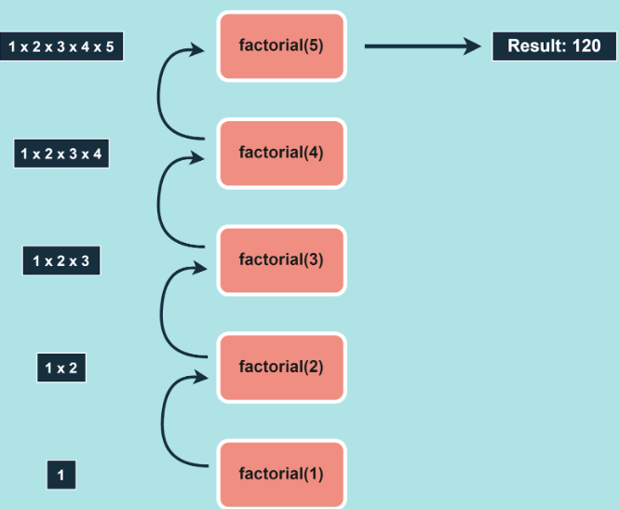
Sri Krishna Institute of Technology
(Approved by AICTE, Accredited by NAAC, Affiliated to VTU, Karnataka)
Example1:
Recursive Case: The part where the function calls itself with a modified argument, moving closer to the base case.
Base Condition: When n == 0 or n < 1 needs to stop.
Base Case: The condition under which the function stops calling itself to avoid infinite recursion.
/skit.org.in

Slide 22
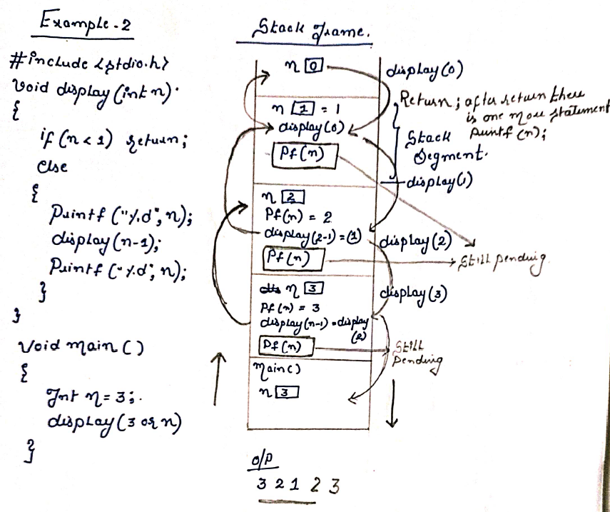
Sri Krishna Institute of Technology
(Approved by AICTE, Accredited by NAAC, Affiliated to VTU, Karnataka)
/skit.org.in

Slide 23
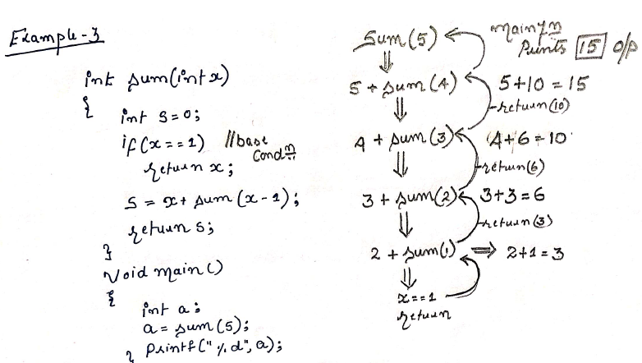
Sri Krishna Institute of Technology
(Approved by AICTE, Accredited by NAAC, Affiliated to VTU, Karnataka)
/skit.org.in

Slide 24
Sri Krishna Institute of Technology
(Approved by AICTE, Accredited by NAAC, Affiliated to VTU, Karnataka)
//GCD Of two numbers
#include<stdio.h>
//#include<conio.h>
int gcd(int m, int n)
{
if(n==0)
return m;
gcd(n, m%n);
}
void main()
{
int a, b, res;
//clrscr();
printf("enter the values for a and b\n");
scanf("%d %d", &a, &b);
res = gcd(a, b);
printf("GCD of two numbers: %d", res);
//getch();
}
GCD/HCF:
GCD: Greatest Common Divisor
HCF: Highest Common Factor
The GCD of two numbers is the largest integer that divides both the
Given numbers. Here we follow Euclid’s formulae which states
GCD(m, n) = n, if n divides a
GCD(n, m%n)
OUTPUT:
enter the values for a and b
150 35
GCD of two numbers: 5
/skit.org.in

Slide 25
Sri Krishna Institute of Technology
(Approved by AICTE, Accredited by NAAC, Affiliated to VTU, Karnataka)
Fibonacci Series:
The general formula for finding the Fibonacci series is
0, if(n==0)
Fib(n) = 1, if(n==1)
fib(n-1)+fib(n-2), otherwise
A s per the formula
Fib(0) ---- 0
Fib(1) ---- 1
Fib(2) ---- fib(1) + fib(0)
OUTPUT:
Enter the value of n
8
Fibonacci series is
21
//FIBONACCI SERIES
#include<stdio.h>
int fibonacci(int);
int main()
{
int n, i, result;
printf("Enter the value of n\n");
scanf("%d", &n);
printf(Fibonacci series is\n");
for(i=0; i<n; i++);
{
result= fibonacci(i);
printf("%d\n", result);
}
return(0);
}
int fibonacci(int n)
{
if(n==0)
return(0);
if(n==1)
return(1);
else
return(fibonacci(n-1)+fibonacci(n-2));
}
/skit.org.in

Slide 26
Sri Krishna Institute of Technology
(Approved by AICTE, Accredited by NAAC, Affiliated to VTU, Karnataka)
TO PRINT THE SERIES:
int main()
{
int n;
printf("Enter the value of n: ");
scanf("%d", &n);
if (n < 1)
{
printf("Please enter a positive number.\n");
}
else
{
printFibonacciRecursive(n);
}
return 0;
}
OUTPUT:
Enter the value of n: 8
Fibonacci Series: 0 1 1 2 3 5 8 13
#include <stdio.h>
int fibonacci(int n)
{
if (n == 0) { return 0; } // Base case 1
else if (n == 1) { return 1; } // Base case 2
else
{return fibonacci(n - 1) + fibonacci(n - 2);} // Recursive case
}
void printFibonacciRecursive(int n)
{
printf("Fibonacci Series:");
for (int i = 0; i < n; i++)
{
printf(" %d", fibonacci(i)); // Print each Fibonacci number
}
printf("\n");
}
TYPES OF RECURSION IN NOTES:
/skit.org.in

Slide 27
Sri Krishna Institute of Technology
(Approved by AICTE, Accredited by NAAC, Affiliated to VTU, Karnataka)
/skit.org.in

Slide 28
Sri Krishna Institute of Technology
(Approved by AICTE, Accredited by NAAC, Affiliated to VTU, Karnataka)
/skit.org.in

